Slide 1
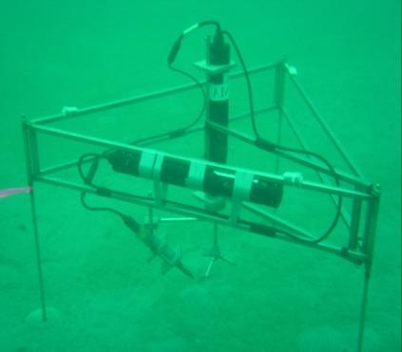

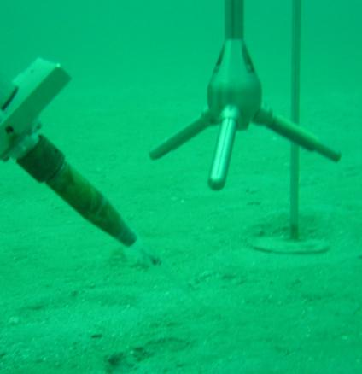
Eddy correlation – basic principles
Source: Peter Berg
Notes:
Instrument used for O2 fluxes: Acoustic Doppler Velocimeter (ADV) and fast responding O2 microelectrode, here mounted on a light frame that will not obstruct natural flow.
ADV records 3 velocity components (x, y, z) based on acoustic echo from particles moving through ADV measuring volume 15 cm below sensor arms. Tip of O2 electrode positioned next to measuring volume. ADV records both velocity and O2 concentration time series aligned perfectly in time. Data usually recorded at 64 Hz and 5 to 30 cm above seafloor.

